Slide 1
Sorting
Il-Chul Moon Dept. of Industrial and Systems Engineering KAIST
icmoon@kaist.ac.kr

Slide 2
Weekly Objectives
This week, we study various sorting algorithms
Objectives are
Understanding their performances
Particularly, why they have such performances
Understanding the algorithms
Able to implement the algorithms
Selection Sort
Just comparison in the sequence with two index iterations
Merge Sort
Divide and conquer approach
Heap Sort
Tricky in the complexity proof
Quick Sort
Importance of a pivot
Counting Sort and Radix Sort
O(N) search

Slide 3
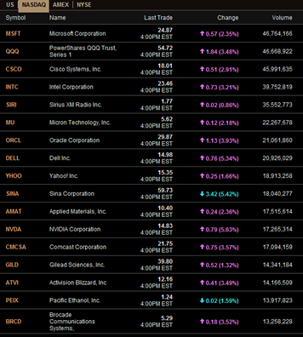
Sorting
https://www.toptal.com/developers/sorting-algorithms
Without a manipulation on data
Just a chunk of data is useless to users
Data should be structured for
Users
Data display
Maybe, sorted table
Computers
Data structure
Maybe, heap, BST, hash….
Most of human decisions asks
Best case
Worst case
Sorting!

Slide 4
O(N²) Sorting
Sorting algorithm
Worst case O(N²) sorting
Without a divide-and-conquer approach
Sequential comparisons with two index iterations
Usually there is a nested loop that ranges
Outer loop: from the first to the end
Inner loop:
from the outer loop’s index to the end
Or, from the first to the outer loop’s index
Variants
Insertion Sort
Selection Sort
Bubble Sort
Pros and Cons?
Cons: time complexity
Pros?
Easy to implement

Slide 5
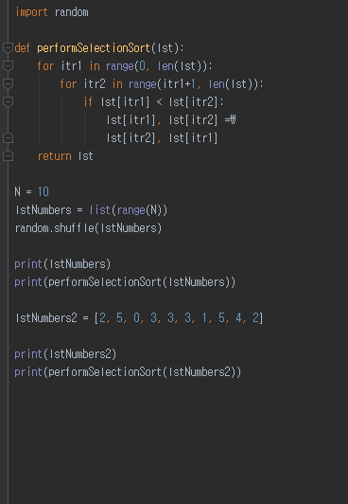

Selection sort algorithm
Examples of algorithms
Insertion, deletion, search of linked lists, stacks, queues…
Sorting of linked lists…
Various sorting methods
Bubble sort, Quick sort, Merge sort…
Selection Sort(list)
For itr1=0 to length(list)
For itr2=0 to length(list)
If list[itr1] < list[itr2]
Swap list[itr1], list[itr2]
Return list
This program uses
Data structure: List
Algorithm: Selection sort

Slide 6
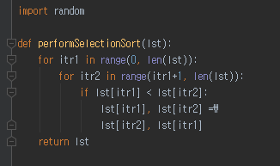

Example of selection sort execution
Let’s observe the execution of the selection sort
Total iterations
= 9+8+….+1
=45 iterations
=$\frac{n(n−1)}{2}$=$\frac{1}{2}n^{2}−\frac{1}{2}n$
[2, 5, 0, 3, 3, 3, 1, 5, 4, 2]
(itr1 = 0, itr2=1..9) = 9 iterations
(itr1 = 0, itr2 = 1)
2 < 5, Hit and swap!!!
list[0] = 5, list[1] = 2 from now
(itr1 = 0, itr2 = 2)
5<0, No hit
(itr1 = 0, itr2 = 3)
5<3, No hit
…..
(itr1 = 1, itr2=2..9) = 8 iterations
….
….
(itr1 = 8, itr2=9..9) = 1 iterations
…..

Slide 7
O(NlogN) Sorting
Sorting algorithm
Worst case O(N²) or O(NlogN) sorting
Average case O(NlogN) sorting
With a divide-and-conquer approach
Divide the target sequence into multiple sequences
Recursively perform sorting of the sub-sequences
Problem is
How to divide
Variants
Quick Sort
Heap Sort
Merge Sort
Pros and Cons?
Cons: bad division leads into O(N²) time complexity
Pros: relatively good time complexity

Slide 8
Merge Sort
Merge sort: One example of recursive programming
Decompose into two smaller lists
Aggregate to one larger and sorted list
MergeSort(3,8,4,2,1,6,7,5)
Decom-position
Phase
3 | 8 | 4 | 2 | 1 | 6 | 7 | 5
MergeSort(3,8,4,2)
MergeSort(1,6,7,5)
3 | 8 | 4 | 2
1 | 6 | 7 | 5
MergeSort(3,8)
MergeSort(4,2)
MergeSort(1,6)
MergeSort(7,5)
3 | 8
4 | 2
1 | 6
7 | 5
Turning Point
3
8
4
2
1
6
7
5
Aggre-gation
Phase
3 | 8
2 | 4
1 | 6
5 | 7
2 | 3 | 4 | 8
1 | 5 | 6 | 7
1 | 2 | 3 | 4 | 5 | 6 | 7 | 8

Slide 9
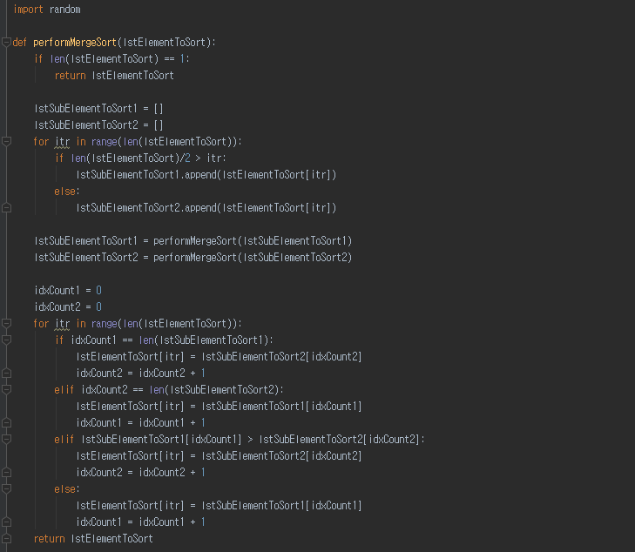
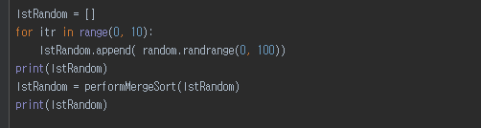

Implementation Example: Merge Sort
Execution Code
Decomposition
Code execution timing!
Before Recursion
= Before Branching out
After Recursion
= After Branching out
Recursion
Aggregation
9

Slide 10
Heap sort
Priority queue
Repeated, dequeue with the highest priority
= dequeue the maximum value
Well-utilizable for sorting
Particularly
Binary heap enables the dequeueing with O(logN)
For dequeueing all elements, it takes O(NlogN)
Same to the sorting all of the elements
How to perform a sorting with a heap (= heap sort)
Given a list whose index ranges from 0 to N
Firstly, Build the binary heap through insertions = O(NlogN)
N items to insert
Percolation takes maximum logN
Is it true? Any better way?
Secondly, take out one element at a time = O(NlogN)
For itr in range(0, N):
Sorted[itr] = Heap.getHighestPriority()

Slide 11
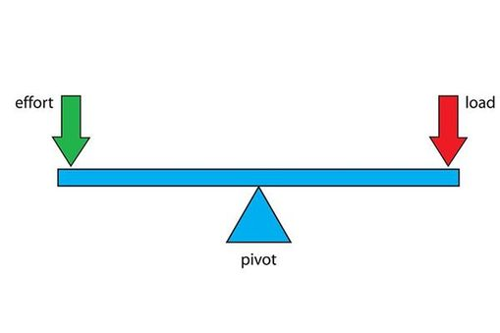
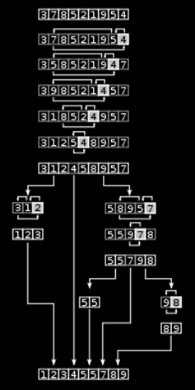
Quick sort
Basic idea
QuickSort(Sequence)
Given a sequence
Select a pivot
Pivot = a threshold to divide the sequence into two sub-sequences
Divide the sequence into two sub-sequences
Sequence with values less than the pivot
Sequence with values greater than the pivot
Return
QuickSort(sequence with less) + Pivot + QuickSort(sequence with greater)
Merge sort forces to divide the sequence in the middle
Always the similar size of the sub-sequence
This divides the sequence with the pivot selection

Slide 12
Importance of pivot in quick sort
What-if the pivot is biased
Let’s assume that
Pivot is always the smallest number
Then?
Just another selection sort
Same to the O(N²) sorting algorithms
Hence the pivot selection is important
Pivot selection approach
Median
Random
Practically, merge sort is more preferable because?
Doesn’t have to worry about the pivot selection
8 comparisons
3 | 7 | 8 | 5 | 2 | 1 | 9 | 5 | 4
1 | 3 | 7 | 8 | 5 | 2 | 9 | 5 | 4
1 | 2 | 3 | 7 | 8 | 5 | 9 | 5 | 4
1 | 2 | 3 | 7 | 8 | 5 | 9 | 5 | 4
1 | 2 | 3 | 4 | 7 | 8 | 5 | 9 | 5
1 | 2 | 3 | 4 | 5 | 7 | 8 | 9 | 5
1 | 2 | 3 | 4 | 5 | 5 | 7 | 8 | 9
1 | 2 | 3 | 4 | 5 | 5 | 7 | 8 | 9
1 | 2 | 3 | 4 | 5 | 5 | 7 | 8 | 9
1 | 2 | 3 | 4 | 5 | 5 | 7 | 8 | 9
Worst case pivot selection

Slide 13
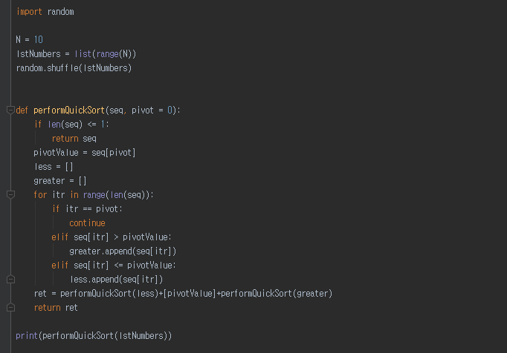

Implementation of quick sort
Random number generation
Pivot selection: always pick the first element
Dividing the sequence into two pieces
Recursive calls

Slide 14
O(N) Sorting
Sorting algorithm
Average case O(N) sorting
Not comparison-based approach
The best performance of the comparison based approach is O(NlogN)
Therefore, should not be based upon comparisons
Rather based upon counting and numeric properties
Variants
Radix Sort
Count Sort
Pros and Cons?
Cons: assumptions and not comparison-based
Pros: best time complexity

Slide 15
Counting Sort
Assumption
The sequence contains integers ranging from 0 to K
Count the occurrence and produce a sequence based upon the counts
Basic idea
For itr from 0 to N
Value = sequence[itr]
Count[value] = Count[value] + 1
For itr1 from 0 to K
For itr2 from 0 to Count[itr1]
Print itr1
Time complexity
O(N+R)
R = the range of the sequence values
N = the size of the sequence
3 | 7 | 8 | 5 | 2 | 1 | 9 | 5 | 4
1 occurrence of 1
1 occurrence of 2
1 occurrence of 3
1 occurrence of 4
2 occurrences of 5
1 occurrences of 7
1 occurrences of 8
1 occurrences of 9
1 | 2 | 3 | 4 | 5 | 5 | 7 | 8 | 9

Slide 16
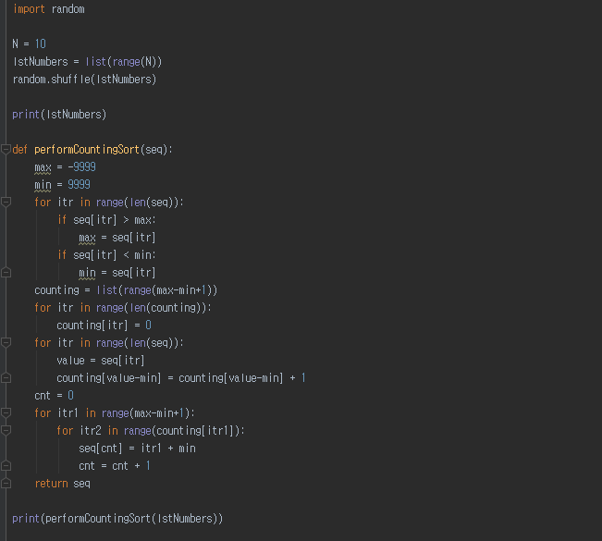

Implementation of counting sort
Random number generation
Preparing the counting space
Perform counting
Print the counted numbers

Slide 17
Radix Sort
Assumption
The sequence contains integers
Sort from the least important digit to the most important digit
Sort from 10002 to 10002
Basic idea
For itr1 from 0 to D
Prepare a bucket list ranging from 0 to 9
For itr2 from 0 to N
digit = itr1th digit of seq[itr2]
Place a seq[itr2] in bucket[digit]
cnt = 0
For itr2 from 0 to 9
For itr3 from bucket[itr2]
seq[cnt] = bucket[itr2][itr3]
Cnt = cnt + 1
Time complexity
O(ND)
D = the digit number of the largest value
N = the size of the sequence
Is this a good approach?
170 | 45 | 75 | 90 | 2 | 24 | 802 | 66
Sort the first digit
170 | 90 | 2 | 802 | 24 | 45 | 75 | 66
Sort the second digit
02 | 802 | 24 | 45 | 66 | 170 | 75 | 90
Sort the third digit
002 | 024 | 045 | 066 | 075 | 090 | 170 | 802

Slide 18
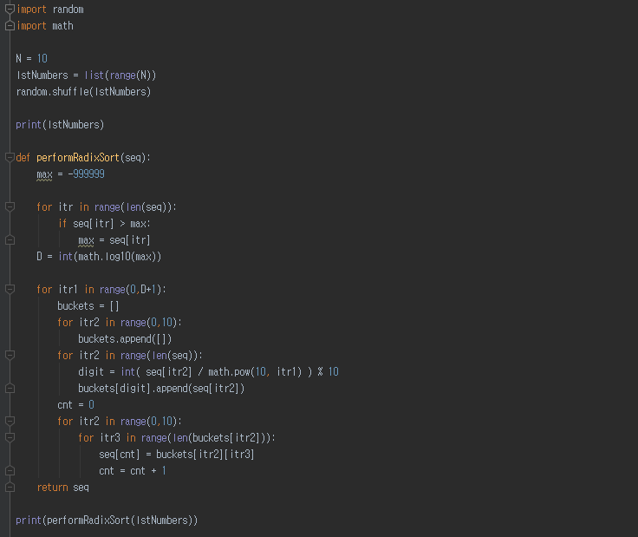

Implementation of radix sort
Random number generation
Finding the digit number
Placing values into buckets
Printing the partially sorted values

Slide 19
Performance of sorting algorithms
 | Average Case | Worst Case
Selection Sort | O(N²) | O(N²)
Merge Sort | O(NlogN) | O(NlogN)
Heap Sort | O(NlogN) | O(NlogN)
Quick Sort | O(NlogN) | O(N²)
Counting Sort | O(N+R) | O(N+R)
Radix Sort | O(ND) | O(ND)
In the real world
Many people do not concern the time complexity of the sorting
Why?
Most of time, people rely on the database and “DESC” and “ASC”
Most of time, people do not give too much thought on this issue
Not a good idea
You need to consider the cost of your system
Development
Maintenance

Slide 20
Further Reading
Introductions to Algorithms by Cormen et al.
pp. 127-173

